Slide 1
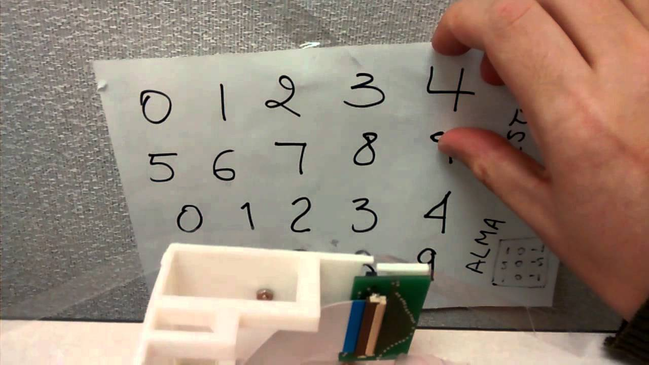
Identify Hand Written Digits
Group 9
Walia, Neeraj, Zhen Zhang

Slide 2
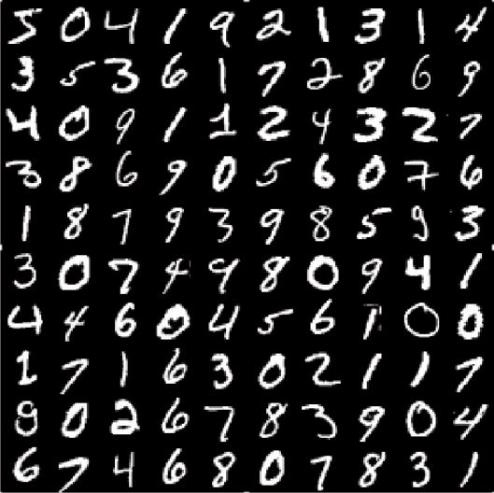
MNIST Dataset
Data contains grey scaled images of hand written digits from 0 to 9.
Each image size is 28 * 28 pixels
Each pixel has a number between 0 to 255 attached to it. The number identifies the darkness of the pixel.
Training data set has 785 columns with first column as label which describes the hand written digit.
We got the data from kaggle website.
Data is already divided into training and test data sets.
For training data set there are 42000 rows of input.
For test data set there are 28000 rows of data.

Slide 3
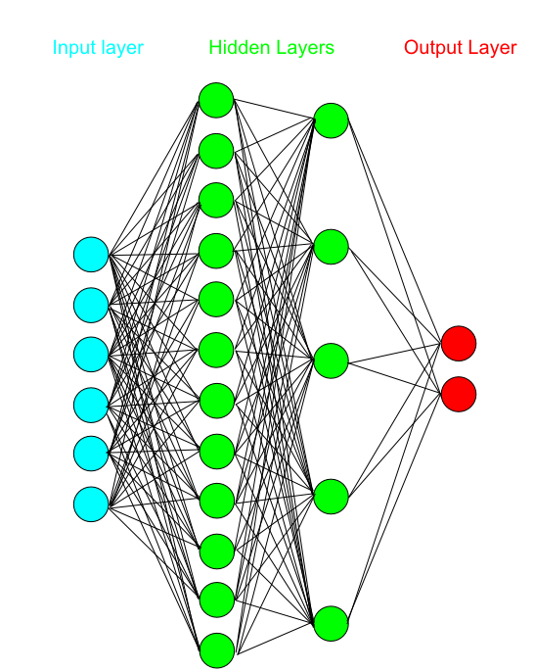
Approach
We built a multi – layer network architecture for this problem. And we tested the number of layers in the network to achieve best accuracy with least complex model.
Along with layers, we have changed other variables to test the accuracy like batch size, epoch etc.
We have designed a Multilayered Perceptron (MLP) and Convolution network for this project and compared their accuracy.
Pytorch framework is used for this project.

Slide 4
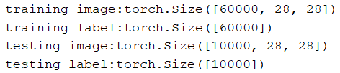
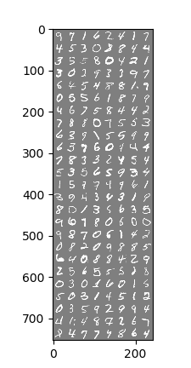
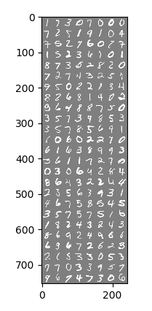
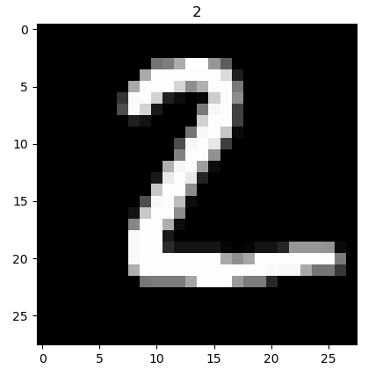
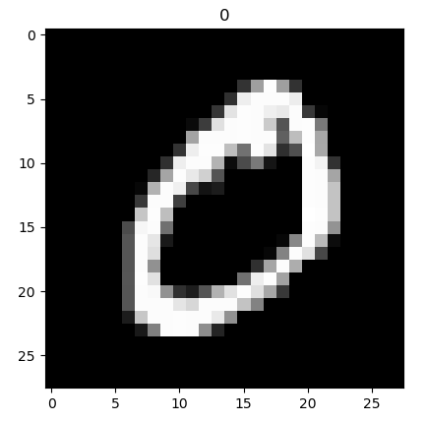
Data Overview
Randomly Training Samples
Randomly Testing Samples
Notes:
In order to see the example of our data, we choose second digit from training dataset and testing dataset which is 0 and 2

Slide 5
Multilayered Perceptron
We have finalized a two-layer network architecture with the following parameters. We chose two layered network because adding more layers was not improving the accuracy of the results.
Epoch_size = 50
Image_dimen = 1
Image_size = 28
Hidden_size = 200
Batch_size = 200
Class_num = 10
We have used CrossEntropyLoss() criterion as this is a classification problem. This criterion helps in training data with number of classes.
We also test with nn.NLLLoss() criterion but did not found any difference in accuracy or performance.

Slide 6
Multilayered Perceptron
optim.SGD() is used to optimize the algorithm. Following are the options selected for this optimizer:
Learning rate = 0.1
Momentum = 0.9
Model got trained using the above mentioned parameters on training data set and its accuracy was test on test dataset.
Accuracy = 98%

Slide 7
Define a Convolution Neural Network
Create
Create a new class which extends nn.Module
Initialize
Initialize all the functions that we will use
Define forward
Define forward function
BATCH_SIZE = 200 LEARNING_RATE = 0.1 EPOCH_SIZE = 50
Hidden_Layers=100
Do not have to define the backward function since it automatically determined by the autograd package.
Notes:
The Module class simply provides a convenient way of encapsulating the parameters, includes some helper functions such as moving data parameters to GPU
we do not have to define the backward function (which is where the gradients are computed), since this is automatically determined by the autograd package.

Slide 8
Initial all Function
Mnist
1,28,28
nn.Squential
Kernel_size:2
nn.Conv2d
Batch Normalization
Relu
Max Pooling
16,28,28
16,14,14
In channel:1
Out channel: 16
Kernel size:5
Stride:1
Padding:2
nn.Squential
16,14,14
In channel:1
Out channel: 32
Kernel size:5
Stride:1
Padding:2
Batch Normalization
Relu
nn.Conv2d
Max Pooling
32,14,14
Kernel_size:2
Fully connected
nn.Linear
32*7*7,10
32,7,7
Notes:
(Kernel size-1)/2 if stride=1

Slide 9
Define Forward Function
Conv1
Conv2
Batch, 32,7,7
Output
layer
Flatten layer
x.view
Batch, 32*7*7

Slide 10
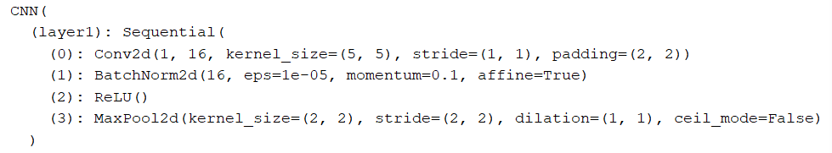
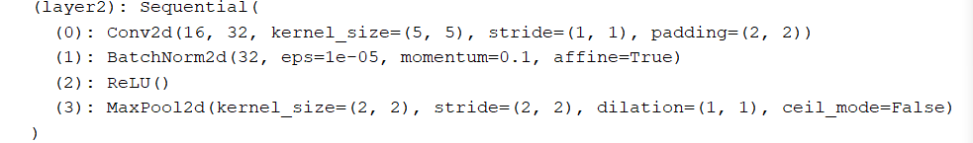
Convolution Neural Network
architecture
Net Architecture

Slide 11
Training Network
Optimizer: Stochastic Gradient Descent
Loss: Cross entropy
Set the training mode
Clear existing gradient
model.train( )
Handle data
Variable( )
.zero_grad( )
Forward
Output=model(image)
Auto calculate gradient
Update the weights
.backward ( )
SGD
Torch.optim
weight = weight - learning_rate * gradient

Slide 12
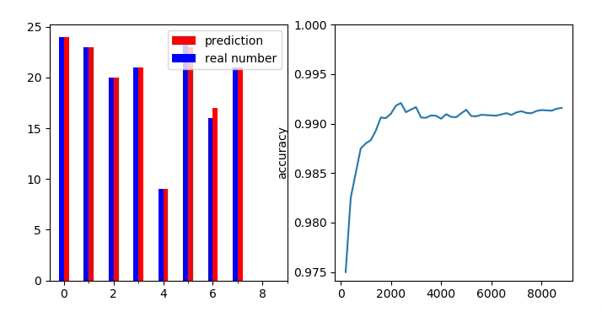
Training Results

Slide 13
Define a Convolution Neural Network
Testing our trained network
Create
model.eval( )
Handle
Variable( )
Forward
Output=model(image)
Notes:
net.eval(), which will turn Dropout and BatchNorm off.
since the test data should not be used to train... cancel backpropagation

Slide 14
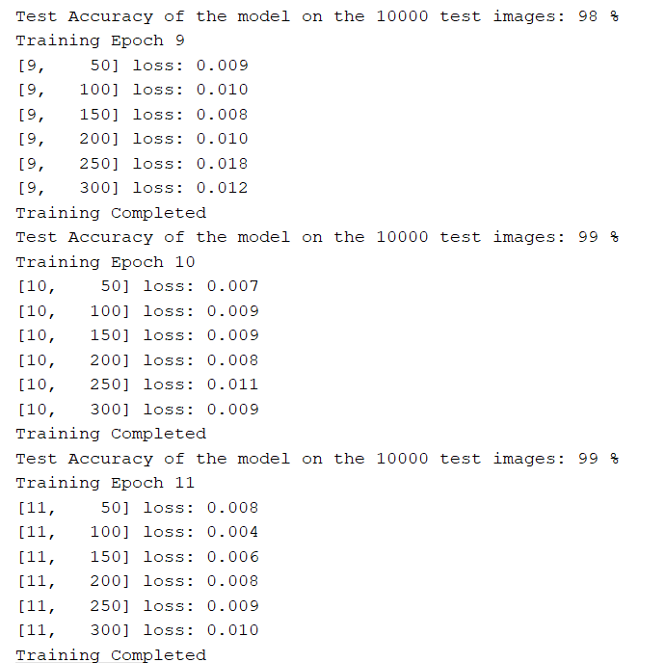
Testing Results
Average Accuracy of the model on the 10000 test images is 99%

Slide 15
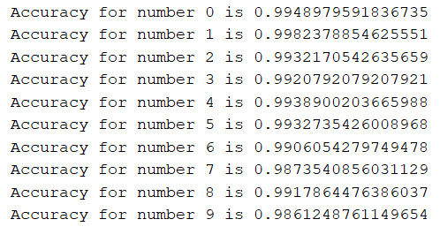

Slide 16
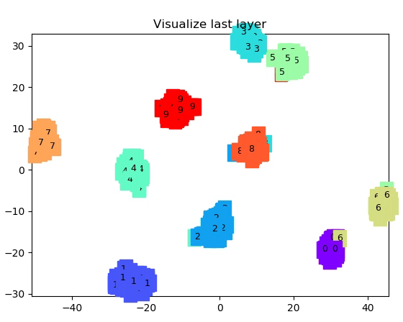
visualization
Almost every digit goes to their own group

Slide 17

Conclusion
We got accuracy of MLP network is rated as 98% and of the convolution network at 99%.
This shows that both networks are highly accurate in reading the hand written digit and with further tweaking they can perform at almost 100% accuracy.
So according to our testing both network are suitable for this project of reading hand written digits

Slide 18
Thank You
End….

